Slide 1
Critical Methods in Cultural Studies
Week 1-2: the visual as archive

Slide 2
‘We still do not know exactly what pictures are, what their relation to language is, how they operate on observers and on the world, how their history is to be understood, and what is to be done with or about them’ (WJT Mitchell, Picture Theory)

Slide 3
Stuart Hall on visual cultures
... There is no single or ‘correct’ answer to the question: ‘What does this image mean?’ or ‘What is this ad saying?’ [this means] work in this area is bound to be interpretative – a debate between not who is ‘right’ and who is ‘wrong’, but between equally plausible, though sometimes competing and contested, meanings and interpretations. (cited in Rose 2007: 2).

Slide 4
Critical Visual Methodology
Suggests that ‘the interpretation of visual images must address questions of cultural meaning and power’ (Rose p. 3)
Cultural significance of the visual and the social practices and power relations in which it is embedded
The power relations and institutions that produce, are articulated through, and can be challenged by ways of seeing and imaging
For Rose, ‘successful interpretation depends on a passionate engagement with what you see’ (p. 4)

Slide 5
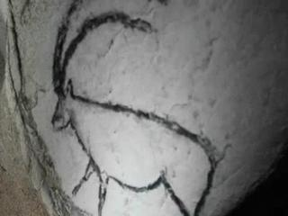
‘Depiction, picturing and seeing are ubiquitous features of the process by which most human beings come to know the world as it really is for them‘ Gordon Fyfe and John Law (1988: 2)
'seeing comes before words. The child looks and recognizes before it can speak.‘ (Berger 1972: 7)

Slide 6
Ocularcentrism
e.g. Rorty on Enlightenment philosophy
Tourist gaze and colonialism
Foucault – surveillance, panopticon
Idea of exhibition
Debord on spectacle
Baudrillard on simulation

Slide 7
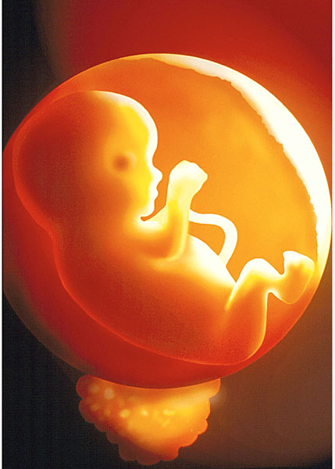
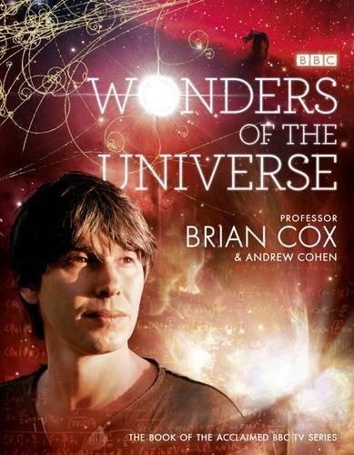
Haraway on scientific vision
‘Vision… becomes unregulated gluttony: all perspective gives way to infinitely mobile vision, which no longer seems just mythically about the god-trick of seeing everything from nowhere, but to have put the myth into everyday practice’ (1991: 189)

Slide 8
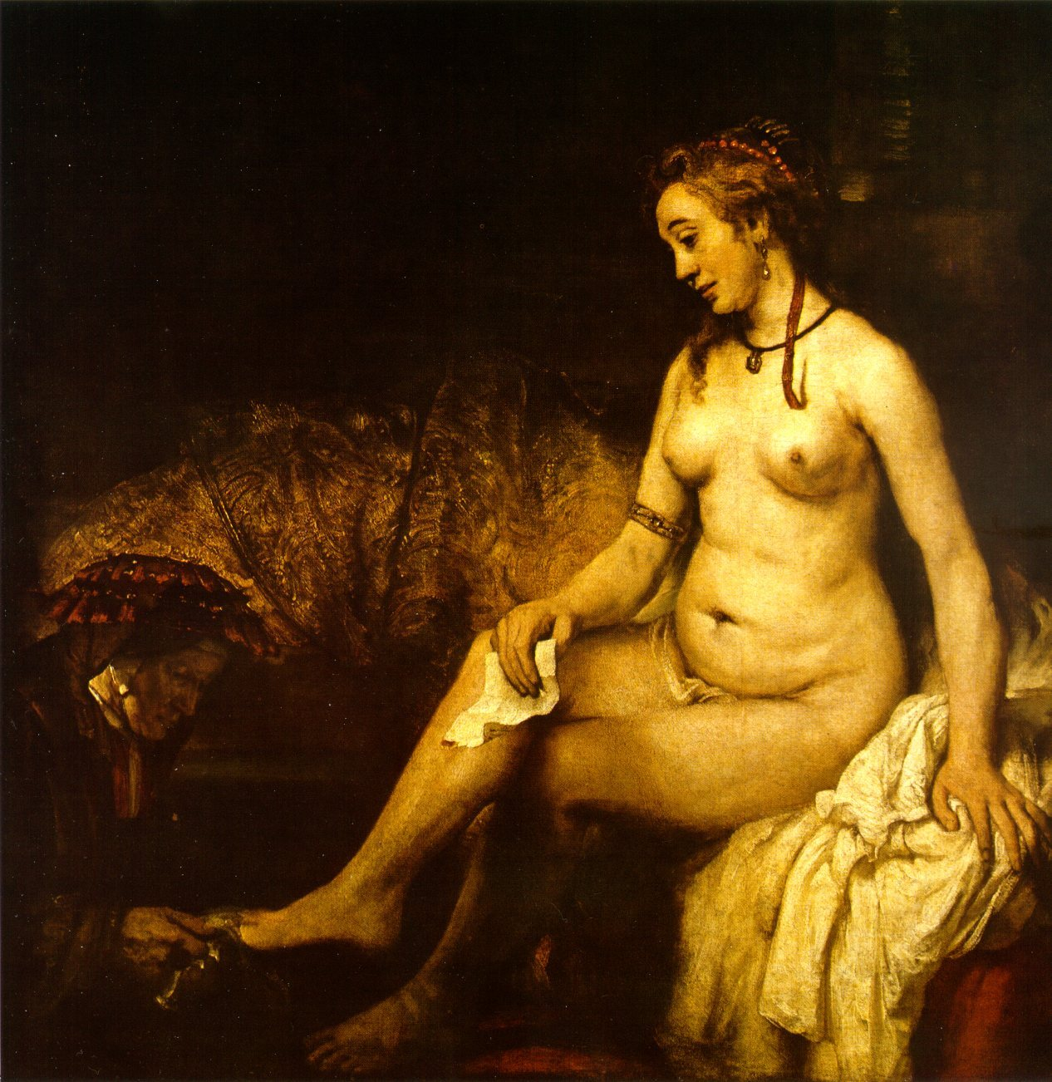
‘Showing Seeing’
'we never look just at the thing; we are always looking at the relation between things and ourselves’ (Berger 1972: 9).
Rembrandt (1654) Bathsheba at her Bath

Slide 9
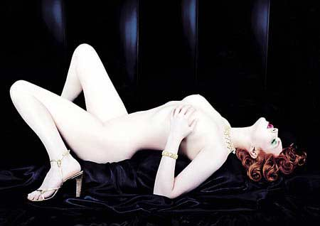

Slide 10
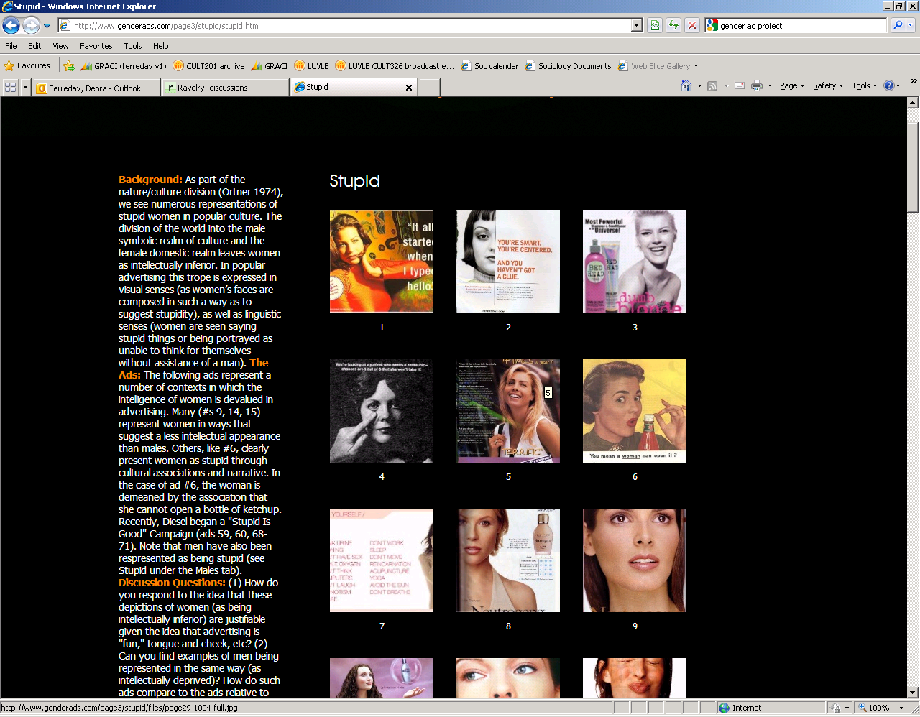
Images and ideology
“This Web site is focused on the cultural intersections of gender and advertising. Its goal is to promote greater awareness of the relationships of gender and advertising as well as an understanding of the social, cultural, political, personal, psychological and other effects of gender and advertising” (Gender Ad Project)

Slide 11

The agency of the image
The important question is not how images "look", but what they can "do''‘ (Pinney 2004: 8)
Mark Rothko Red, Orange, Tan, and Purple, 1949

